Slide 1
Analysıng travel habıts
Tan Berk Doker’s DSA210 Project

Slide 2

MY DATASET
Using the ‘timeline’ feature of Google Maps, I kept track of my travel data.
I extracted the data from Google Takeout to analyse it for this project.

Slide 3

My hypothesıs
I travel more on weekends compared to weekdays due to having free time from school.

Slide 4

My motıvatıon
I travel between Acıbadem and Sabancı almost everyday. I had just left school to my way home and I got stuck on traffic. While I was looking at Google Maps to look at the time left to home, I said ‘Analysing my

Slide 5
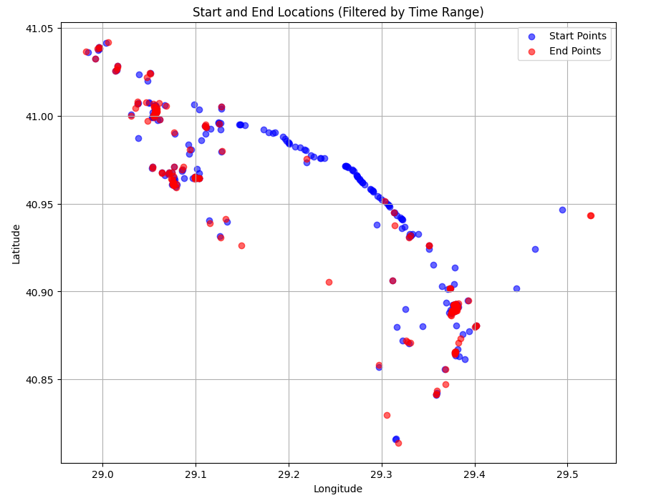
Analysıng my path
Scatter plot on the left is generated by using the coordinate data gathered from Google Maps. The consecutive blue dots highlights the TEM Highway. Multiple red dots around 41.00-29.05 is Acıbadem, where I live. The pattern with tight dots right below Acıbadem is Bağdat Street, where I spend most of my time on weekends.

Slide 6
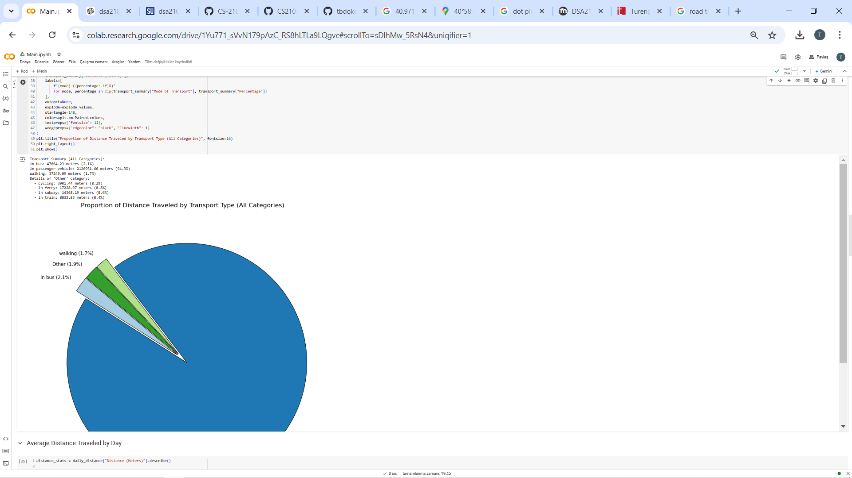
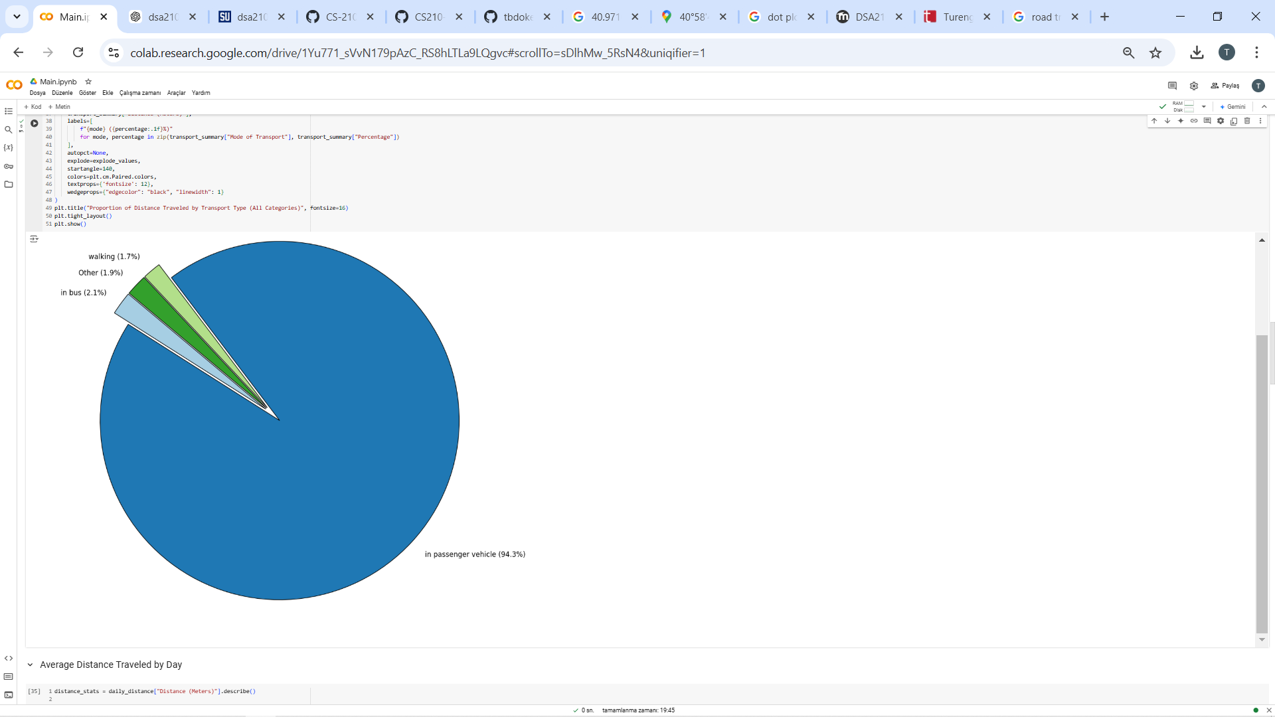
Means of transport ı used durıng travellıng
Big portion of my travels were in a car, followed by walking and public bus. To give a better visual understanding to the viewer, I grouped the transportation with little portions together.

Slide 7
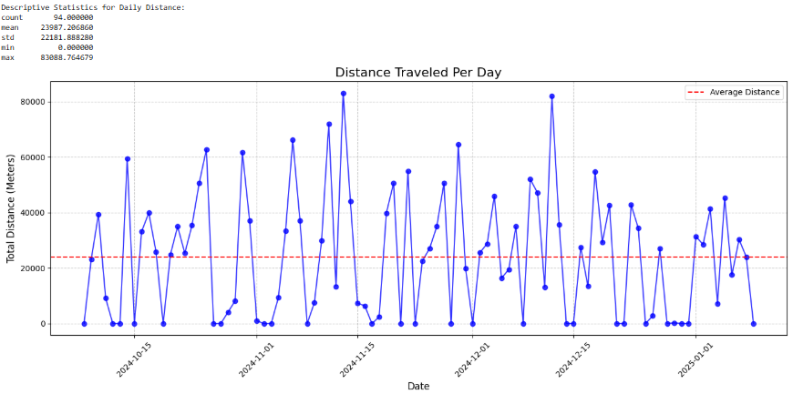
Dıstance traveled each day
Then I decided to check the distance I traveled every day to later group this data as weekdays and weekends.
From the graph, we can observe that there isn’t really a constant travelling habit day to day, as the graph is up and down.

Slide 8
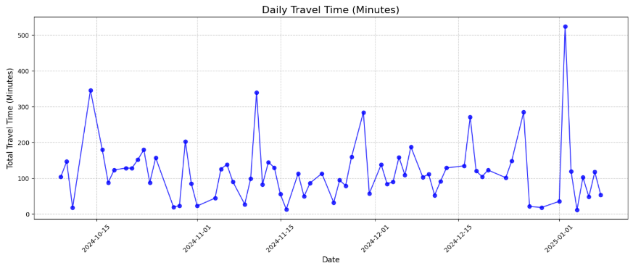
Tıme spent travellıng each day
After analysing the distance, I decided to visualise the time I spent everyday travelling to see if I can find a pattern.
I also wanted to draw a heatmap to show the distribution of the time spent regarding to the clock.

Slide 9

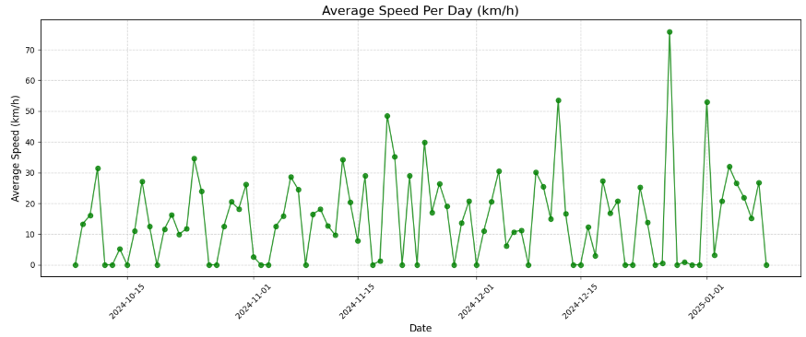
Average speed each day
I was curious what my speed was during my travels. I found the speed data by dividing ‘Distance per day’ to ‘Time Spent per day’.

Slide 10
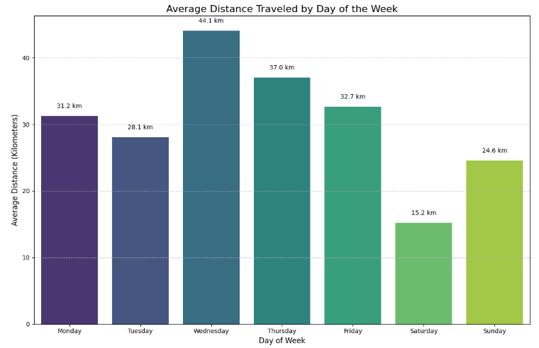
Average dıstance traveled by day of the week
This is the graph with the biggest importance for my hypothesis.
The mean of the distance traveled weekdays is 34,62.
The mean of the distance traveled weekends is 19,9.

Slide 11

Hypothsesıs Concluded
x̄ D - x̄ E = 14.72
Null Hypothesis: x̄ D - x̄ E = 0
Especially by analiysing the last graph, there is big difference between the sample means within a good sample size.
So, my decision is to reject the null hypothesis.

Slide 12
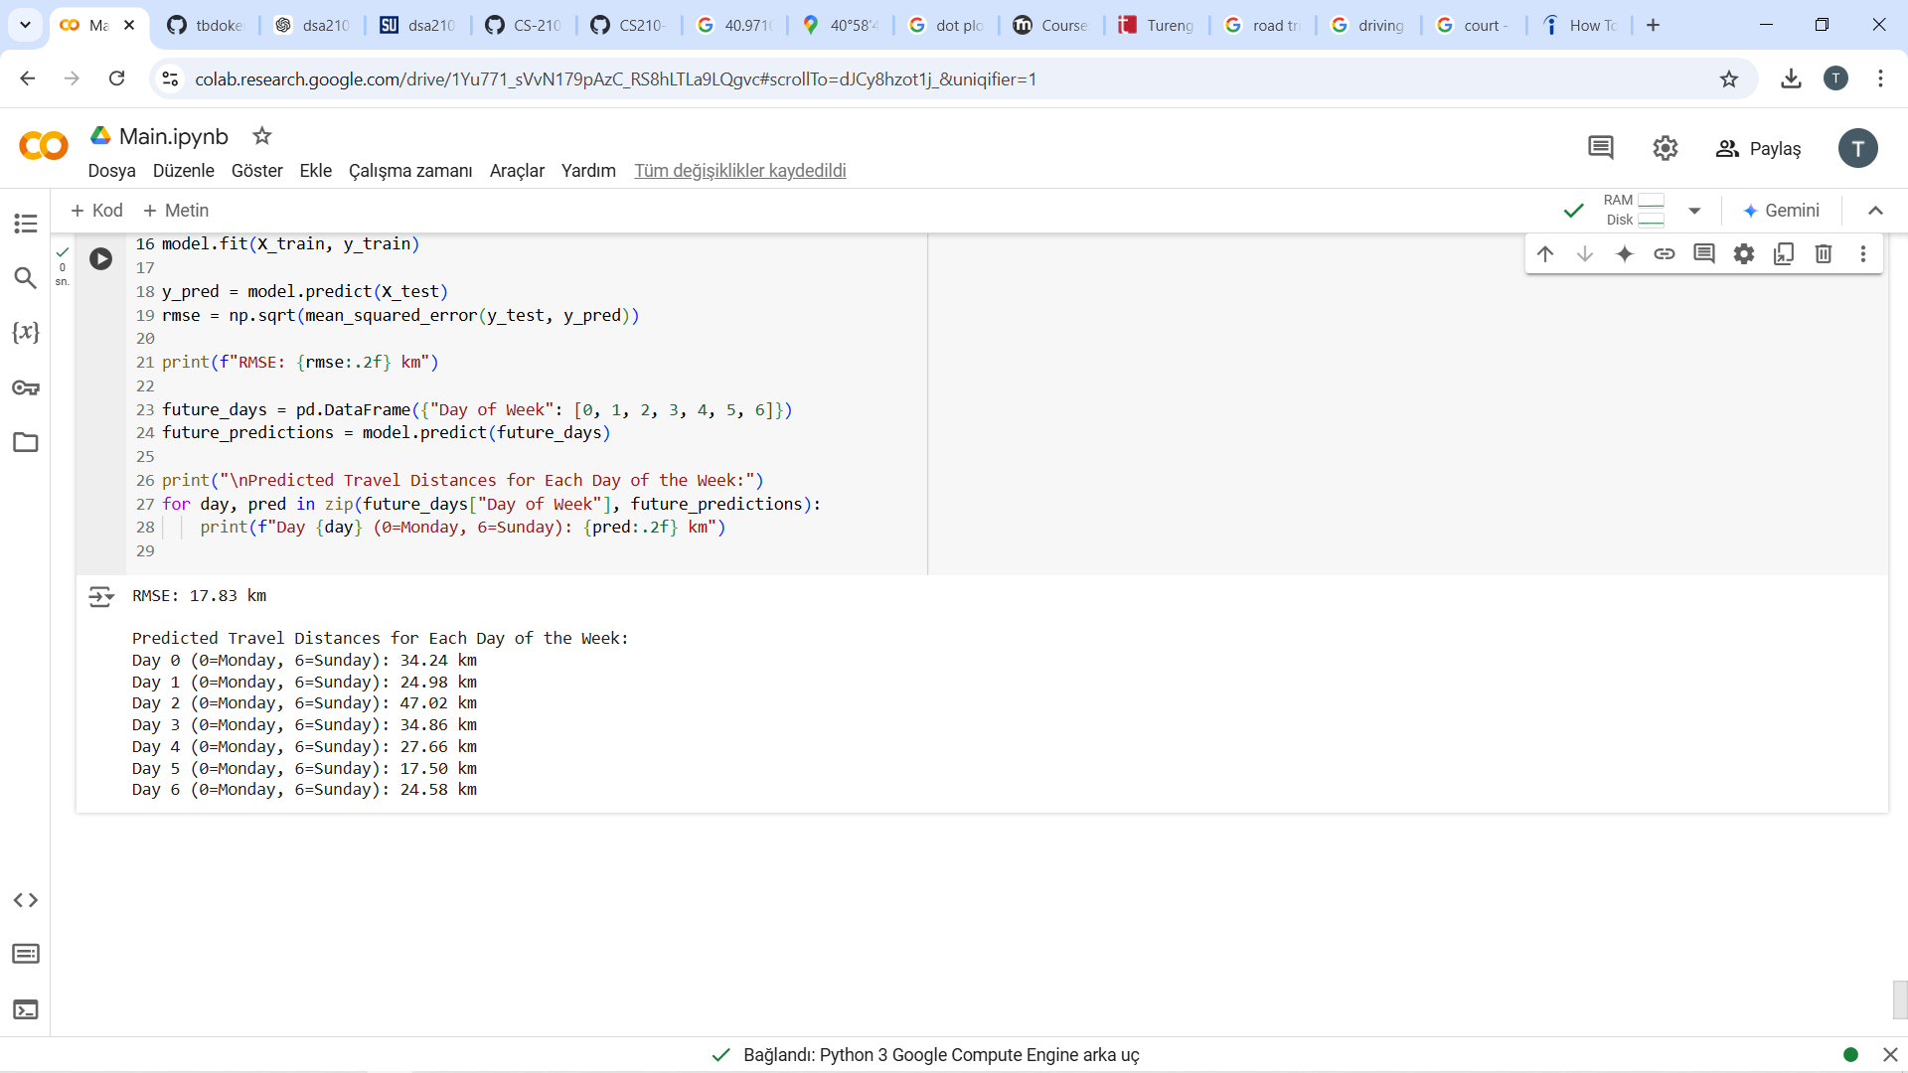
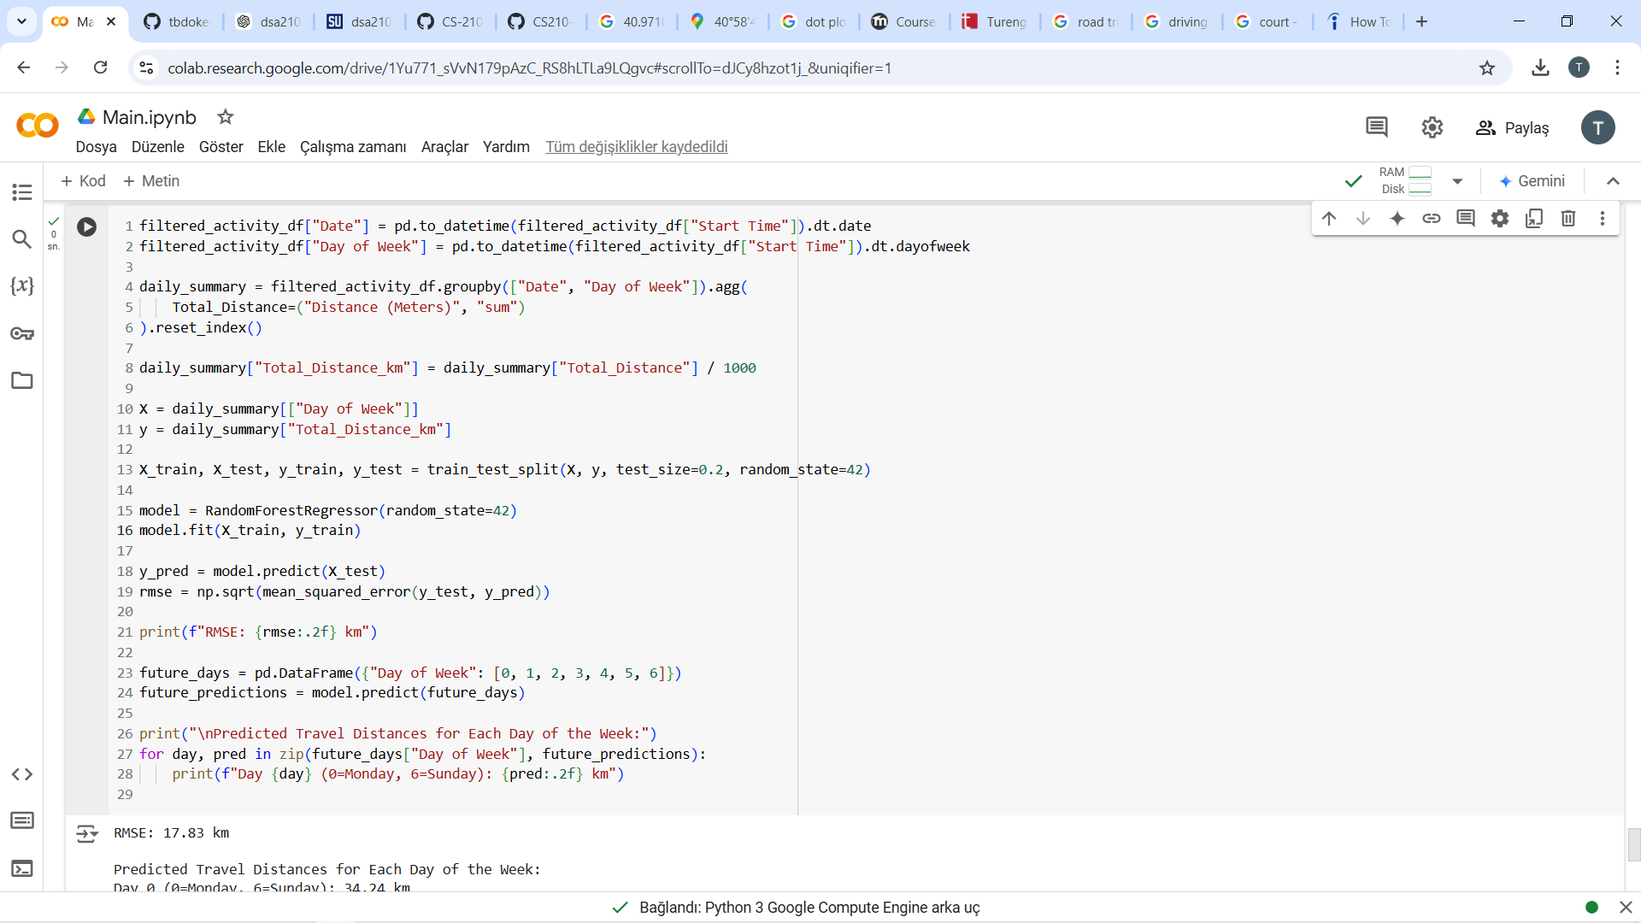
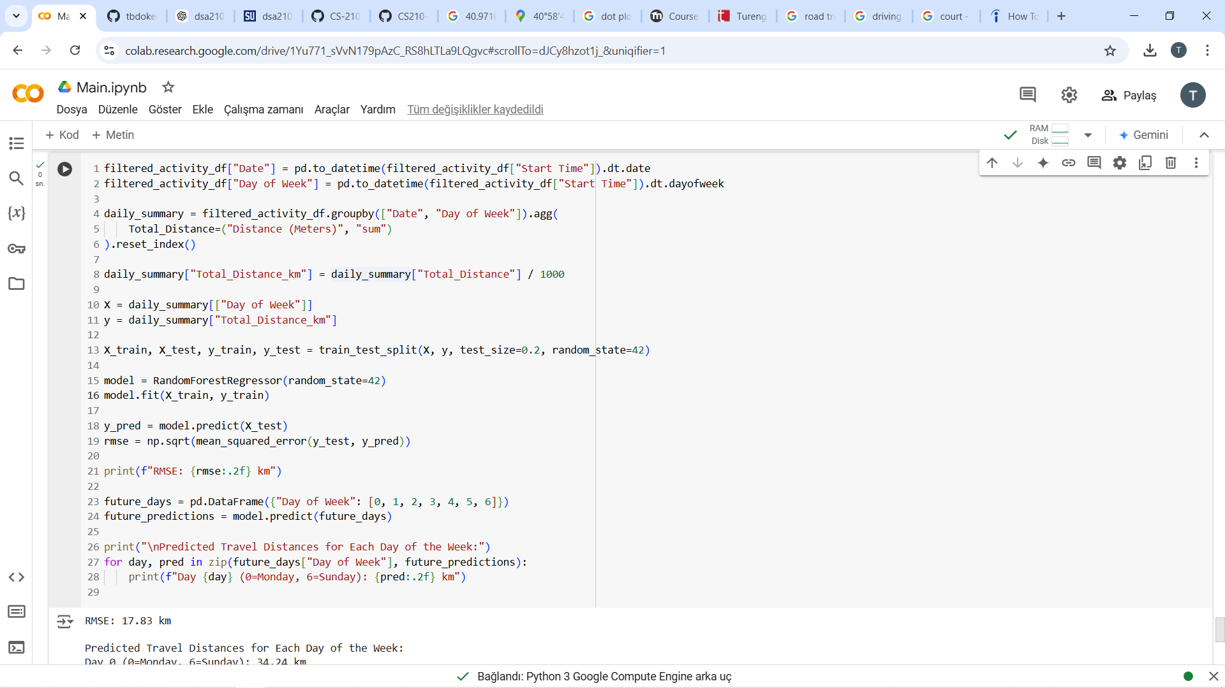
ML MODEL TO PREDICT FUTURE OUTCOMES.
I tried to come up with a ML model that predicts the travel distances for each day of the week.

Slide 13
Lımıtatıons and struggles
Like I mentioned before, I had a problem while drawing a heatmap that represent the time spend travelling each day distributed among 24 hours.
I also wanted to make a graph to show the top 10 places that I visited the most, but had a problem while parsing the dataset.

Slide 14



